Slide 1
Plotting, A4
Learning goals:
Understand how common Python plotting libraries relate with each other.
Walk through questions on A4
COGS 108 Fall 2020
Discussion 6
Sidharth Suresh
OH: Wed 12pm-1pm on Zoom

Slide 2
Inner join vs. Left join vs. Right join vs. Outer Join
Email | Name
sam@ucsd.edu | Sam
jen@ucsd.edu | Jen
kay@ucsd.edu | Kay
min@ucsd.edu | Min
Email | Order
jen@ucsd.edu | Keyboard
sam@ucsd.edu | Mouse
kay@ucsd.edu | Cable
wade@ucsd.edu | Lamp
Inner joins drop all rows without a matching value.
Left joins keep all rows in the left table, even if values do not have a match.
Right joins keep all rows in the right table, even if values do not have a match.
Outer includes all the rows and columns in both the tables.
Inner join:
Email | Name | Order
sam@ucsd.edu | Sam | Mouse
jen@ucsd.edu | Jen | Keyboard
kay@ucsd.edu | Kay | Cable
Left join:
Email | Name | Order
sam@ucsd.edu | Sam | Mouse
jen@ucsd.edu | Jen | Keyboard
kay@ucsd.edu | Kay | Cable
min@ucsd.edu | Min | NULL

Slide 3
Plotting

Slide 4
Why are there so many ways to make the same plot?
All of these do the same thing: plt.hist(df['income10'], 25) df['income10'].hist(bins=25) df.hist('income10', bins=25)
In Python, most image-based plots created using Matplotlib.
plt.hist plt.bar plt.plot etc.
Pandas gives shortcuts for matplotlib plots. Lines 2 and 3 are shortcuts for line 1.

Slide 6
Seaborn
My personal favorite is the seaborn library.
Makes common statistical charts easy to create, like bar plots with confidence intervals.
Again, seaborn is really just a bunch of shortcuts for matplotlib.
https://seaborn.pydata.org/tutorial.html

Slide 7
For more details
Making good plots is a key skill! This just scratches surface.
You can get many great jobs just by being able to make informative data visualizations.
For more, see Ch 6 of textbook.ds100.org.

Slide 8
A4 Walkthroughs

Slide 9
A4 quick tips
1d: Your DF cells should have `\n` at the end (same for 1e)
2b: Don’t manually make a new Series — slice a column out of a DF
2e: Use a slice with multiple boolean expressions
2f: Your for loop should loop through the index of a DF
3b: Don’t do anything to the zip column
3f: Loop through the DF’s index again. Your 3-digit zip codes should be stored as strings, not ints.

Slide 10
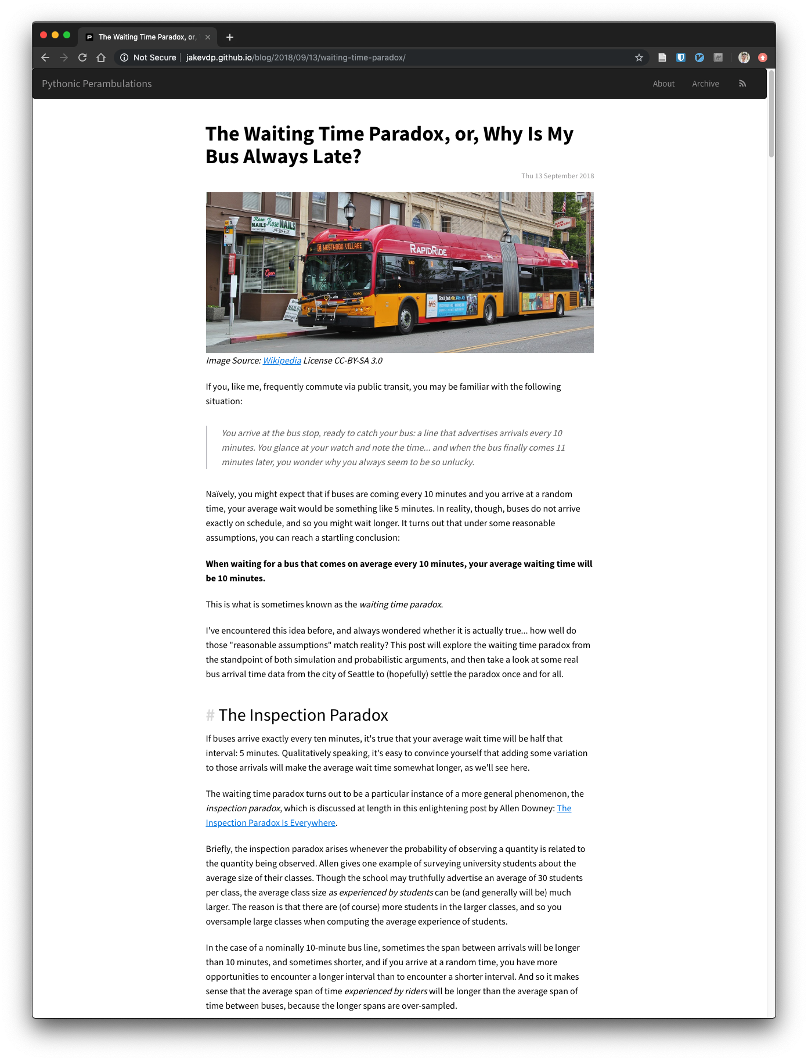
Preview of next week
An easy way to set up a personal website using Jupyter notebooks and GitHub.
A5 question walkthroughs

